Slide 1
Individual Differences in Degree of Discounting: Do Different Procedures and Measures Assess the Same Construct?

Slide 2
Delay Discounting
Delay discounting refers to the decrease in the subjective (present) value of a reward as the time to its receipt increases.
Delay discounting has been assumed to measure impulsiveness, self-control, and ability to delay.
The discounting function has been used to characterize delay discounting for groups and individual differences:
Steep discounting has been linked to smoking, alcohol and drug misuse, etc.

Slide 3
Measures of Delay Discounting
Two major measures of delay discounting:
Adjusting-Amount Delay Discounting Procedure
Monetary Choice Questionnaire (MCQ)
No head-to-head systematic, extensive comparison between these two tasks has been conducted.
Purpose of this study: Compare these two measurement procedures in order to determine whether they measure the same underlying construct.

Slide 4
Method
Participants collected from Prolific (N = 150) and MTurk (N = 275) completed both discounting procedures.

Slide 5
Adjusting-Amount Procedure
Three delayed amounts are used ($30, $80, and $500) in the adjusting amount task.
Each amount involves four delays: 7, 30, 90, and 180 days.

Slide 6
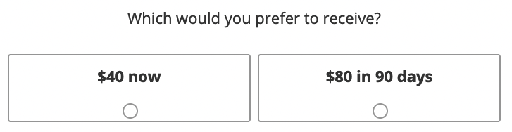

Slide 7
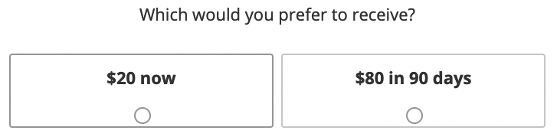

Slide 8
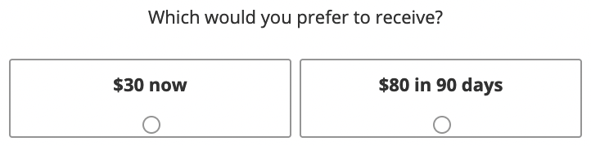

Slide 9
MCQ Procedure
MCQ consists of 27 questions and can be divided into three sets of amount (i.e., $25-35, $50-60, and $75-85).
Each question presented two options. One option was an immediate, smaller reward; the other option was a delayed, larger reward.

Slide 10
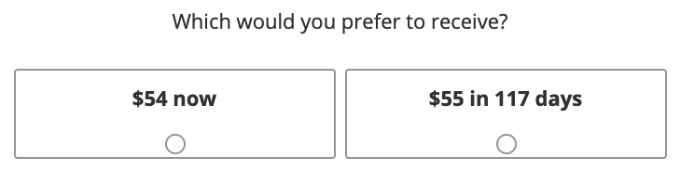
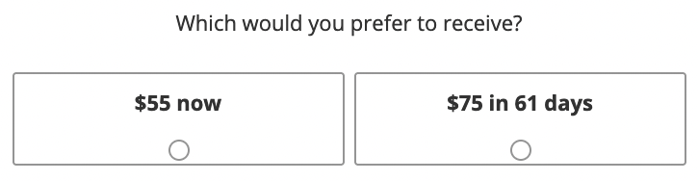

Slide 11
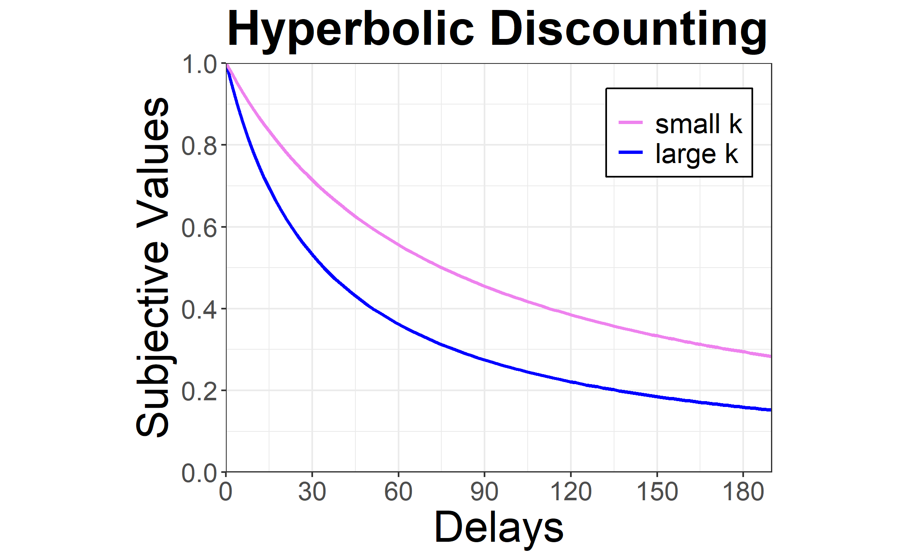
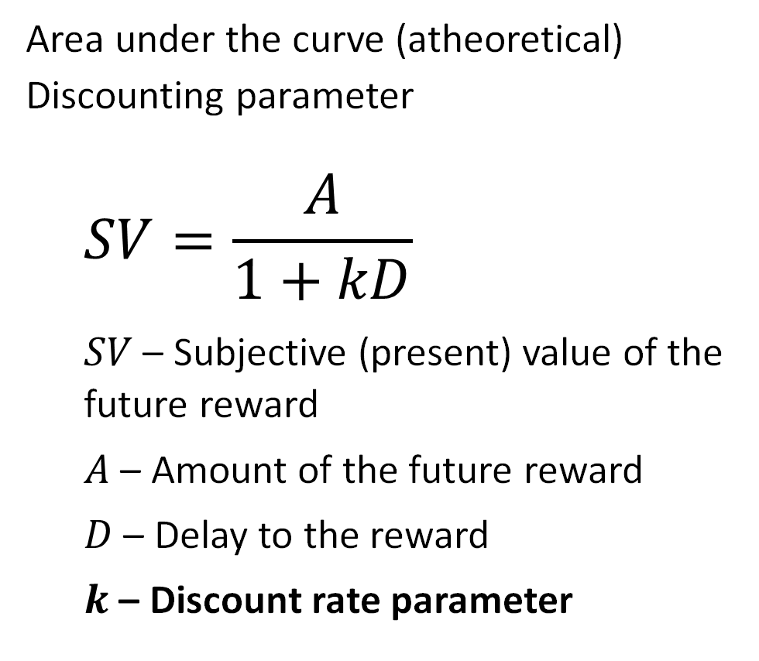
Data analysis – Adjusting-amount
Area under the curve (atheoretical)
Discounting parameter
$$SV=\frac{A}{1+kD}$$
$SV$ – Subjective (present) value of the future reward
$A$ – Amount of the future reward
$D$ – Delay to the reward
$k$ – Discount rate parameter

Slide 12
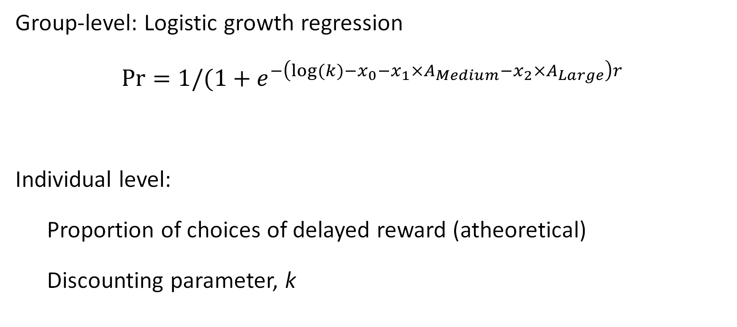
Data analysis – MCQ
Group-level: Logistic growth regression
$$Pr=1/(1+e^{−\left(log⁡(k)−x_{0}−x_{1}×A_{Medium}−x_{2}×A_{Large}\right)r}$$
Individual level:
Proportion of choices of delayed reward (atheoretical)
Discounting parameter, k

Slide 13
k = .00016
k = .006

Slide 14
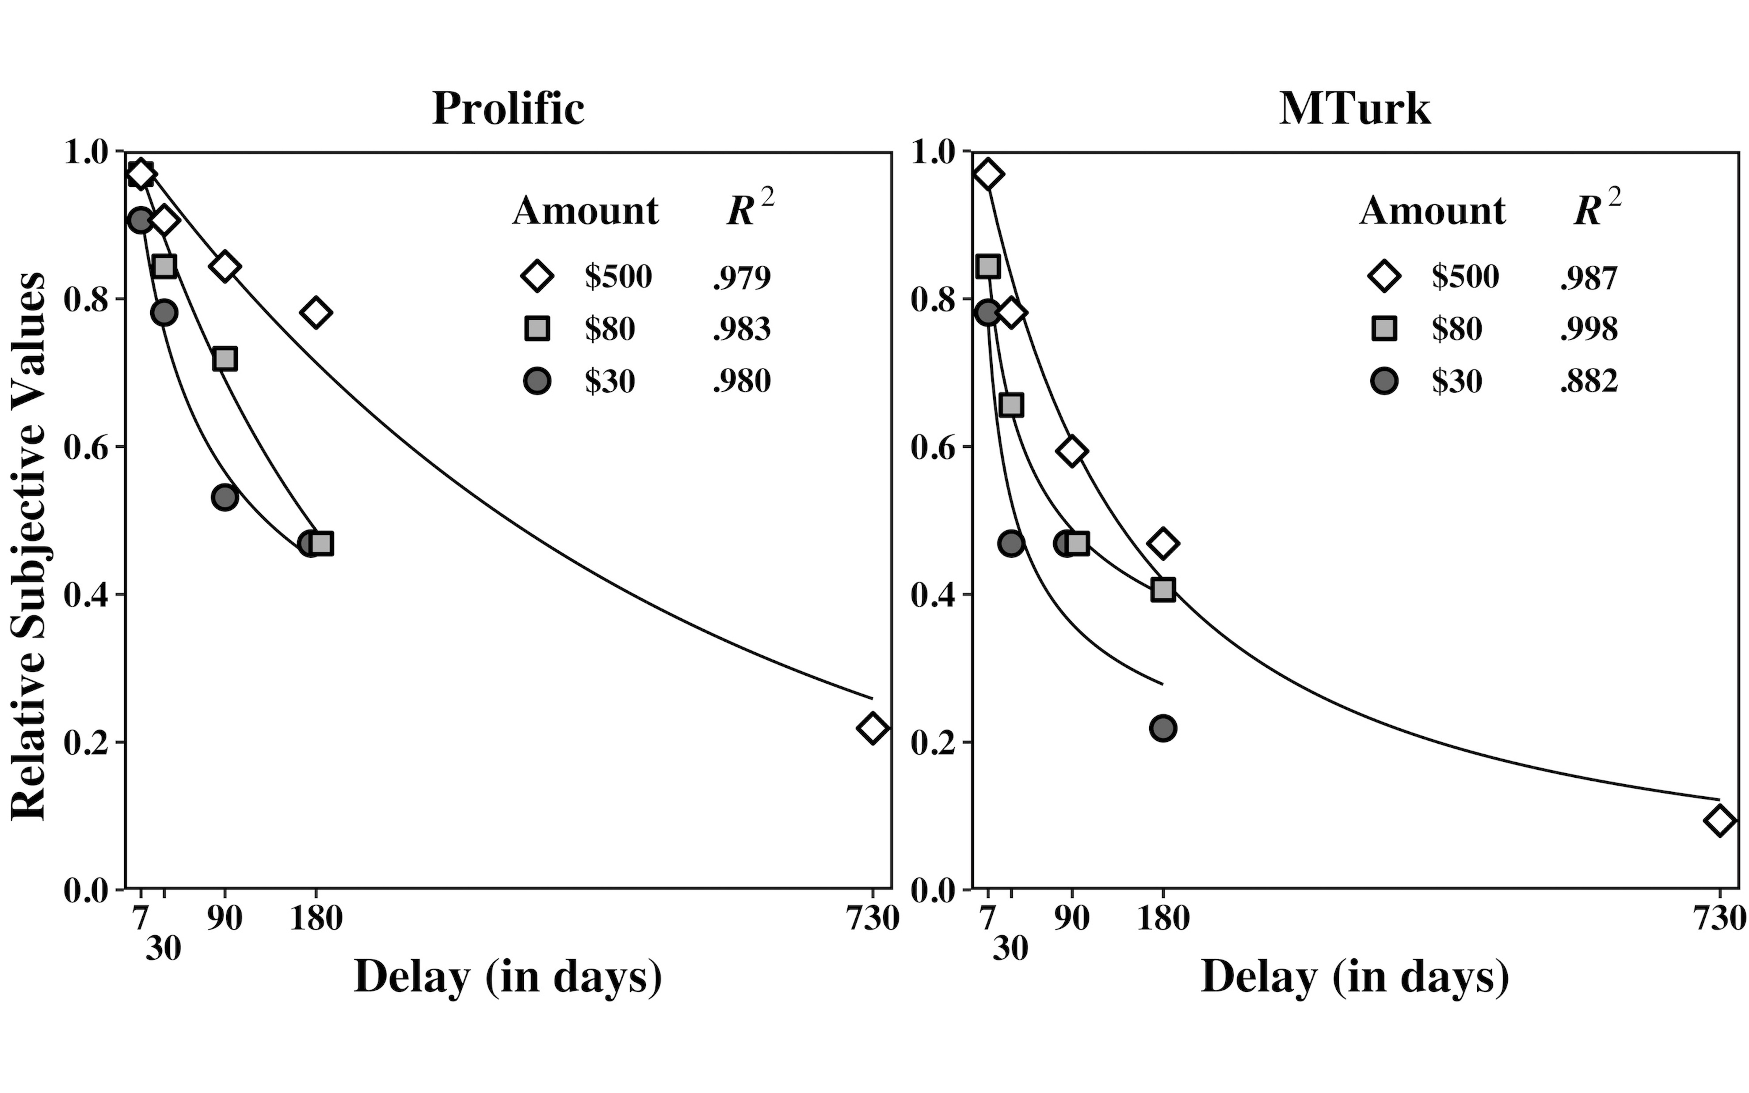
Magnitude Effect
Adjusting-amount: Hyperboloid discounting functions

Slide 15
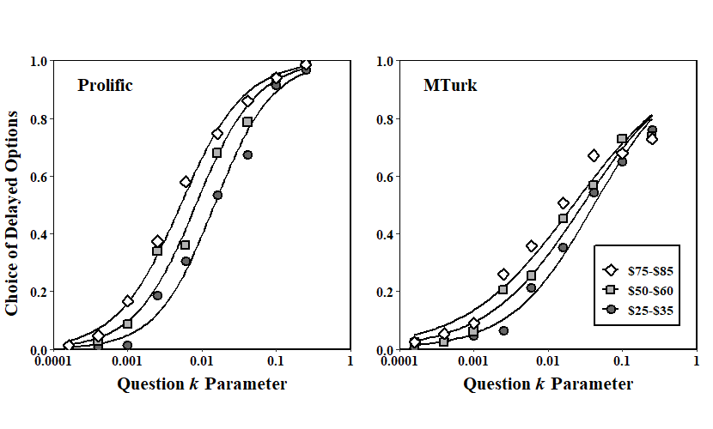
Magnitude Effect
MCQ: Logistic growth regression

Slide 16
Reliability & Robustness
Adjusting-Amount
 | Prolific |  | MTurk
AuC | $30 | $80 | $30 | $80
$80 | 0.841 | - | 0.877 | -
$500 | 0.737 | 0.870 | 0.841 | 0.879
 | Prolific |  | MTurk
log k | $30 | $80 | $30 | $80
$80 | 0.840 | - | 0.879 | -
$500 | 0.769 | 0.838 | 0.866 | 0.886
 | Prolific | MTurk
$30 | -0.977 | -0.959
$80 | -0.976 | -0.964
$500 | -0.844 | -0.947

Slide 17
Reliability & Robustness
MCQ
 | Prolific |  | MTurk
Prop | $25-35 | $50-60 | $25-35 | $50-60
$50-60 | 0.898 | - | 0.897 | -
$75-85 | 0.837 | 0.882 | 0.890 | 0.925
 | Prolific |  | MTurk
log k | $25-35 | $50-60 | $25-35 | $50-60
$50-60 | 0.902 | - | 0.887 | -
$75-85 | 0.834 | 0.874 | 0.841 | 0.895
 | Prolific | MTurk
$25-35 | -0.995 | -0.967
$50-60 | -0.999 | -0.983
$75-85 | -0.995 | -0.975

Slide 18
Same Construct???
log(k) | Prolific | MTurk
$30 ($25-35) | 0.768 | 0.741
$80 ($75-85) | 0.788 | 0.770
AuC - Prop | Prolific | MTurk
$30 ($25-35) | 0.809 | 0.790
$80 ($75-85) | 0.821 | 0.820

Slide 19
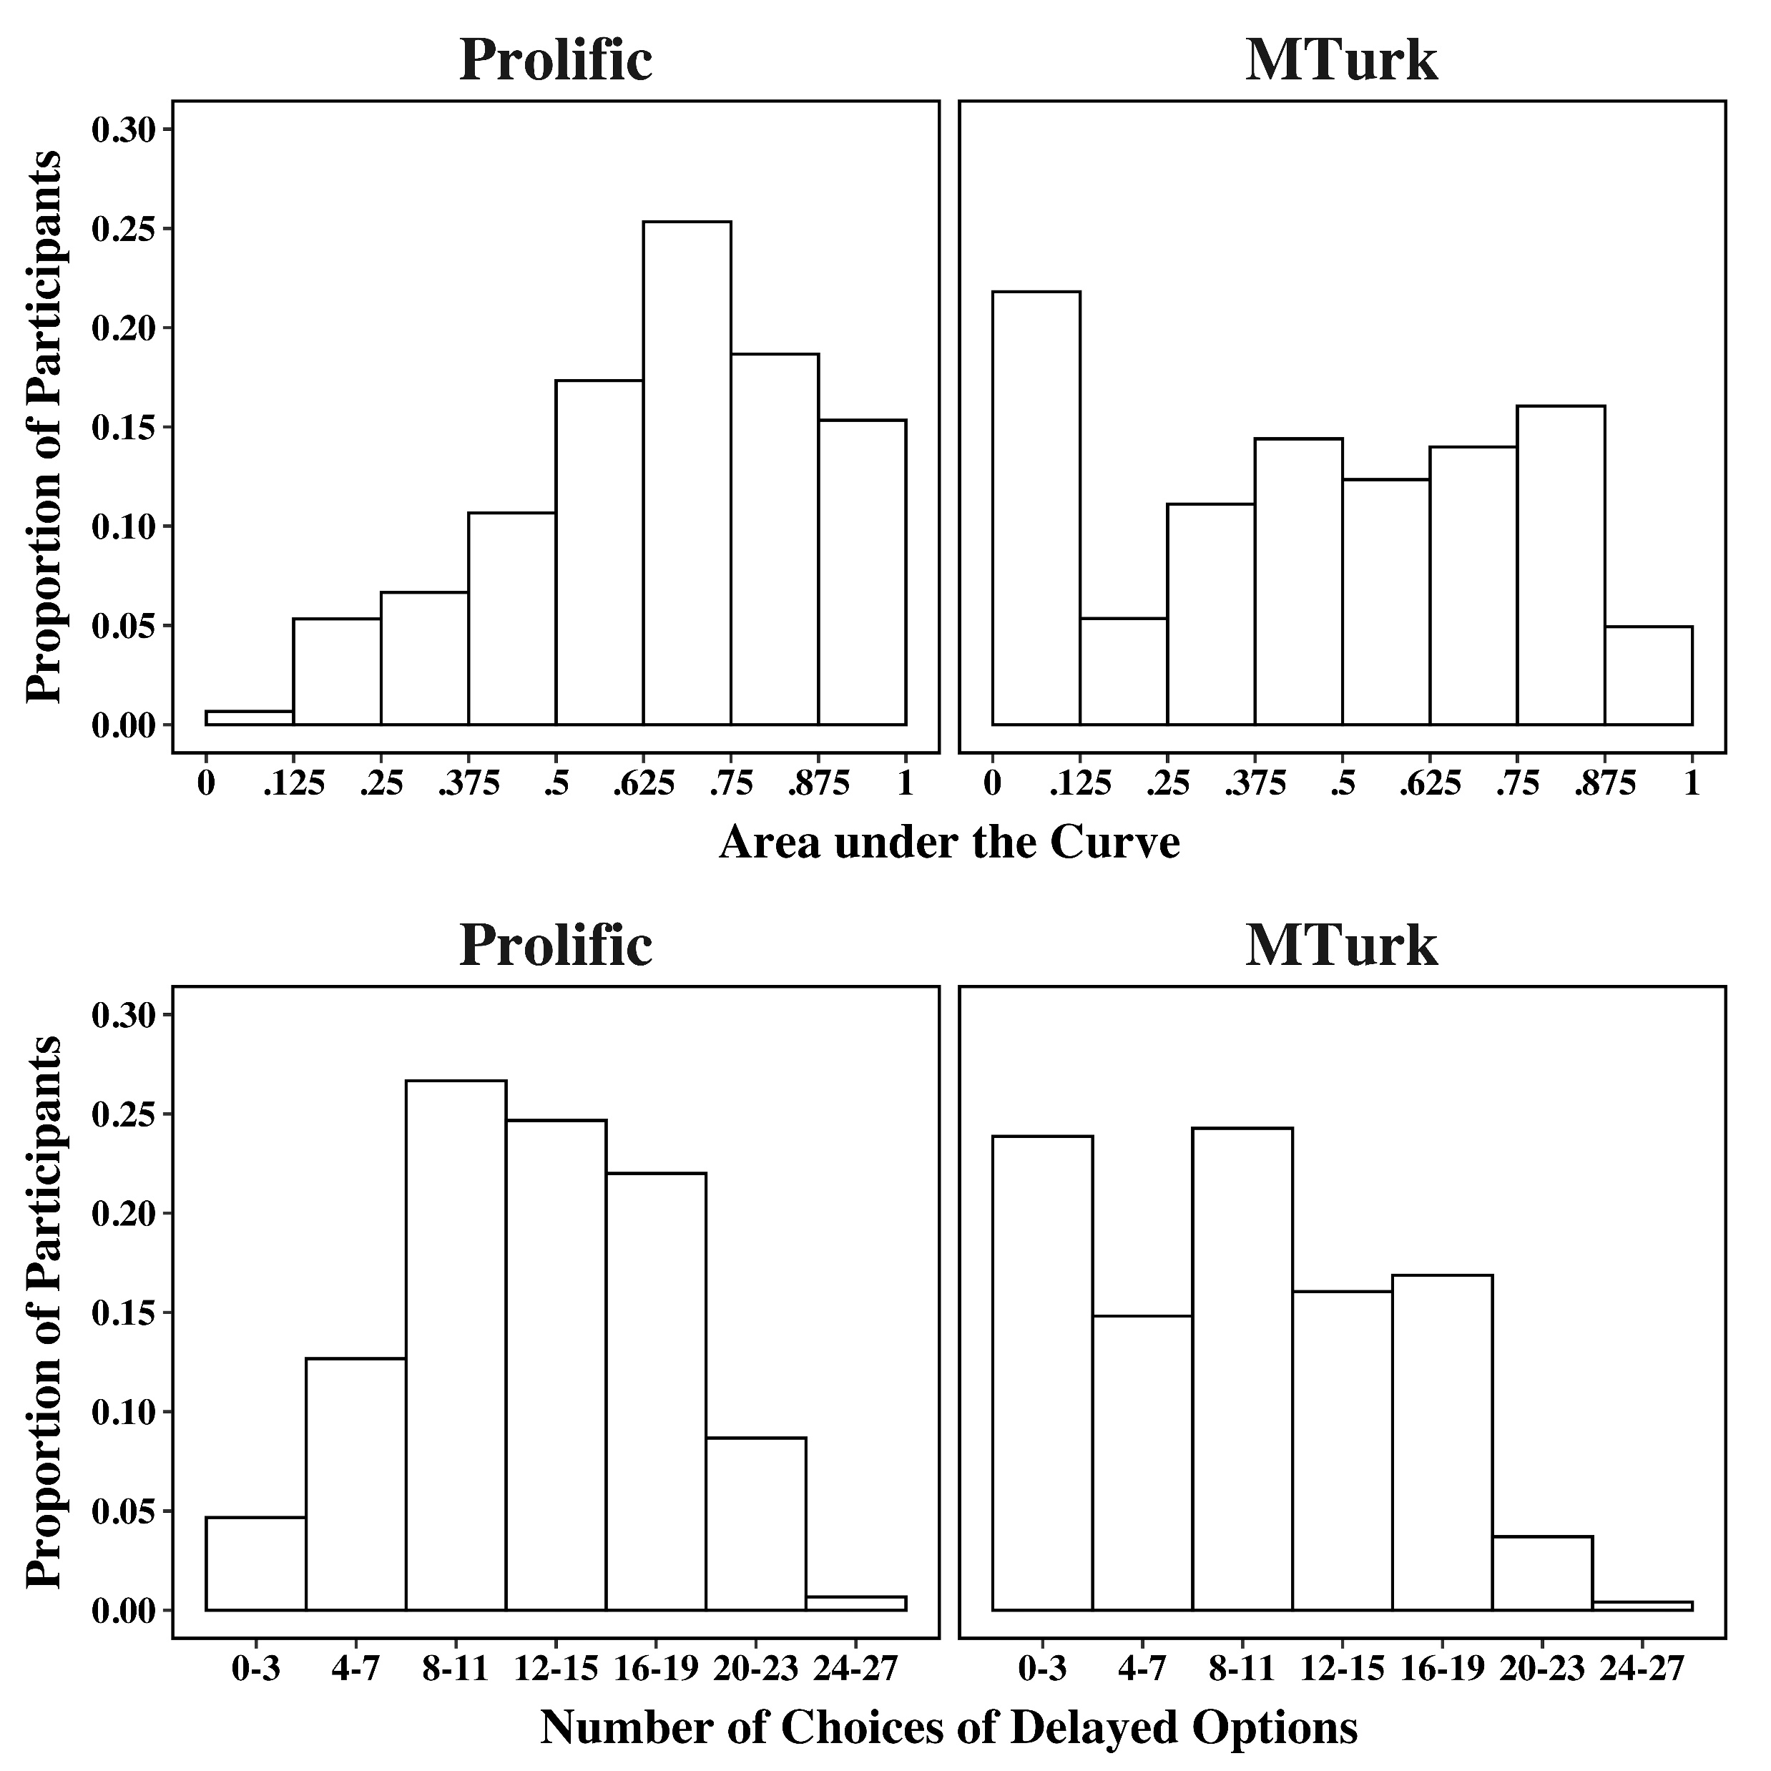

Slide 20
Delayed Loss
Adjusting-Amount Procedure vs. MCQ

Slide 21
Delayed Loss – Method
500 participants from Prolific and completed both discounting tasks.

Slide 22
Adjusting amount
Three delayed amounts are used ($90, $240, and $1,500) in the adjusting amount task.
Each delayed amount involves four delays: 4, 18, 60, and 108 months.

Slide 23


Slide 24


Slide 25


Slide 26
MCQ
MCQ consists of 27 questions and can be divided into three sets of amount (i.e., $90, $155, and $240).
Each question presented two options. One option was an immediate, smaller payment; the other option was a delayed, larger payment.

Slide 27
Data analysis – Adjusting amount
Area under the curve

Slide 28
Data analysis – MCQ
Proportion of choices of immediate payment

Slide 29
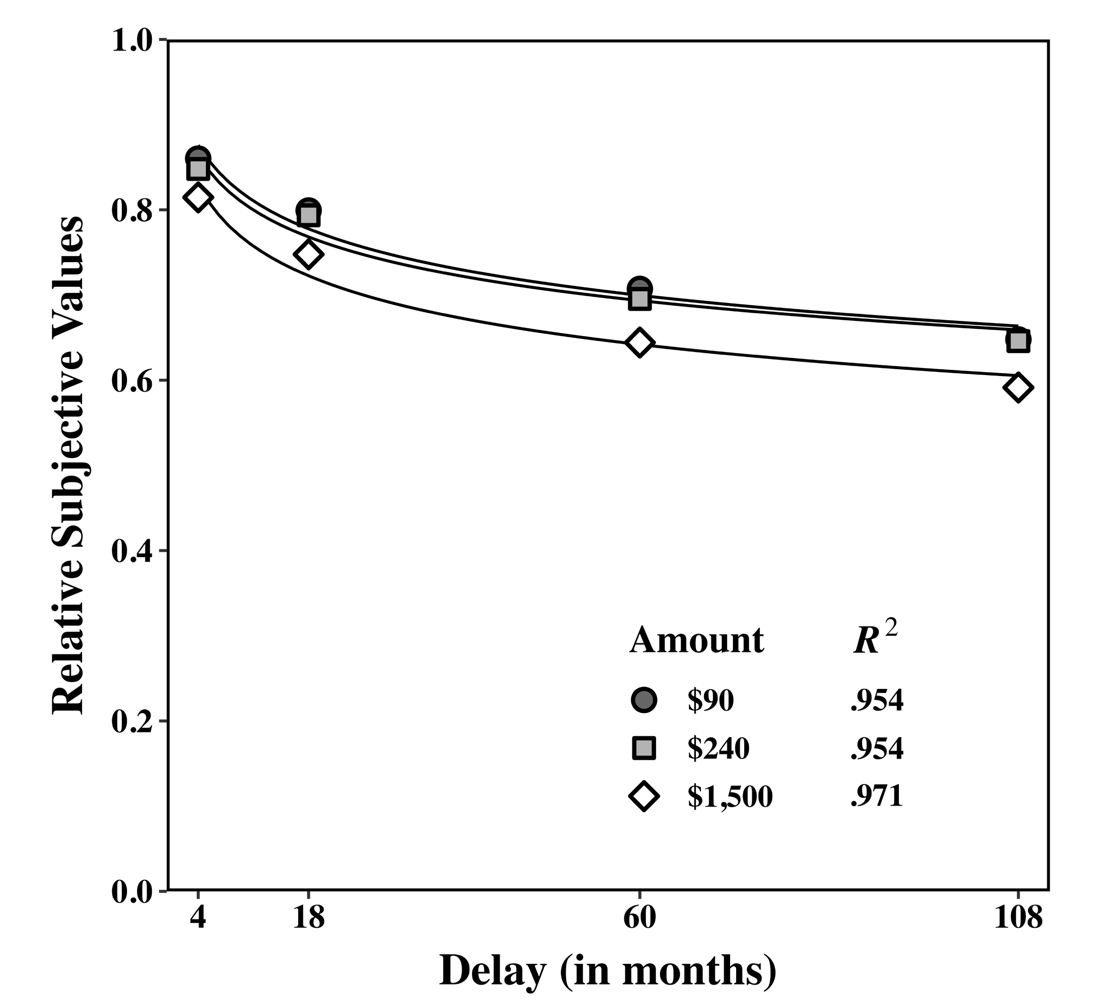
Magnitude Effect
Adjusting amount: Area under the curve (AuC)

Slide 30
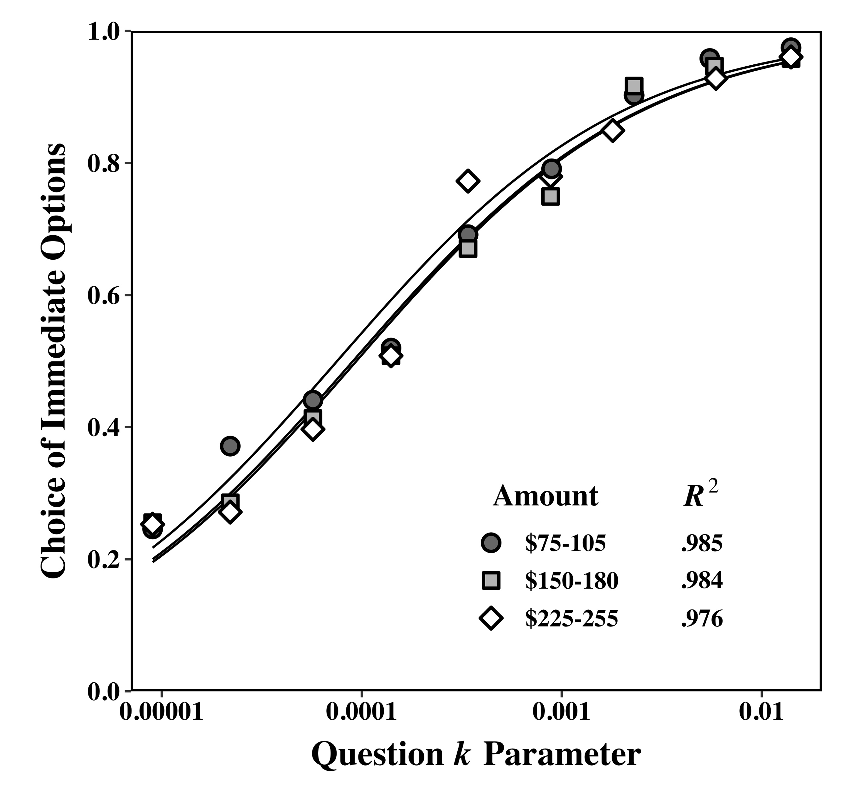
Amount effect
MCQ: Logistic growth regression

Slide 31
Reliability & Robustness
Adjusting amount: Area under the curve (AuC)
AuC | $90 | $240
$240 | 0.776 | -
$1,500 | 0.625 | 0.767

Slide 32
Reliability & Robustness
MCQ: Immediate-Choice Proportion
Prop | $75-105 | $150-180
$150-180 | 0.858 | -
$225-255 | 0.801 | 0.887

Slide 33
Same Construct???
 | AuC - Prop
$90 ($75-105) | 0.767
$240 ($225-255) | 0.805

